Slide 1
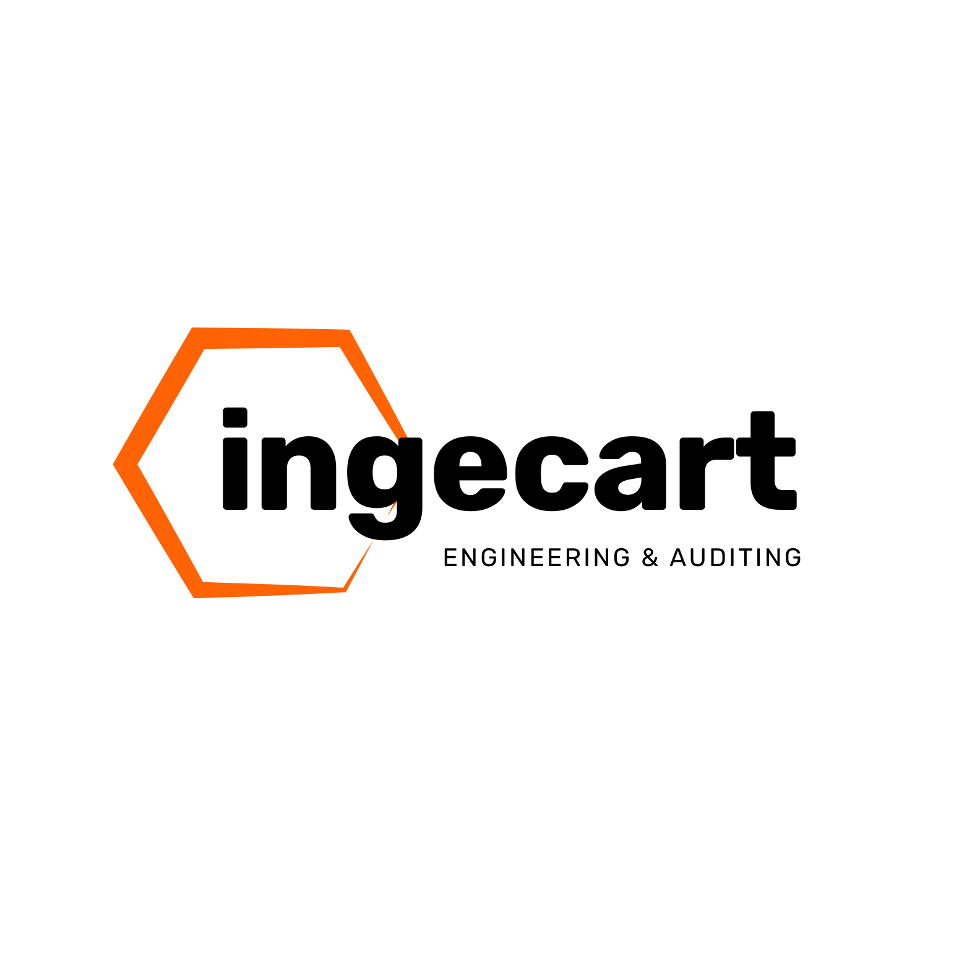
TAILORED AUTOMATION
& INTRALOGISTICS
The Corrugated Plant
of the Future
Starts Here

Slide 2

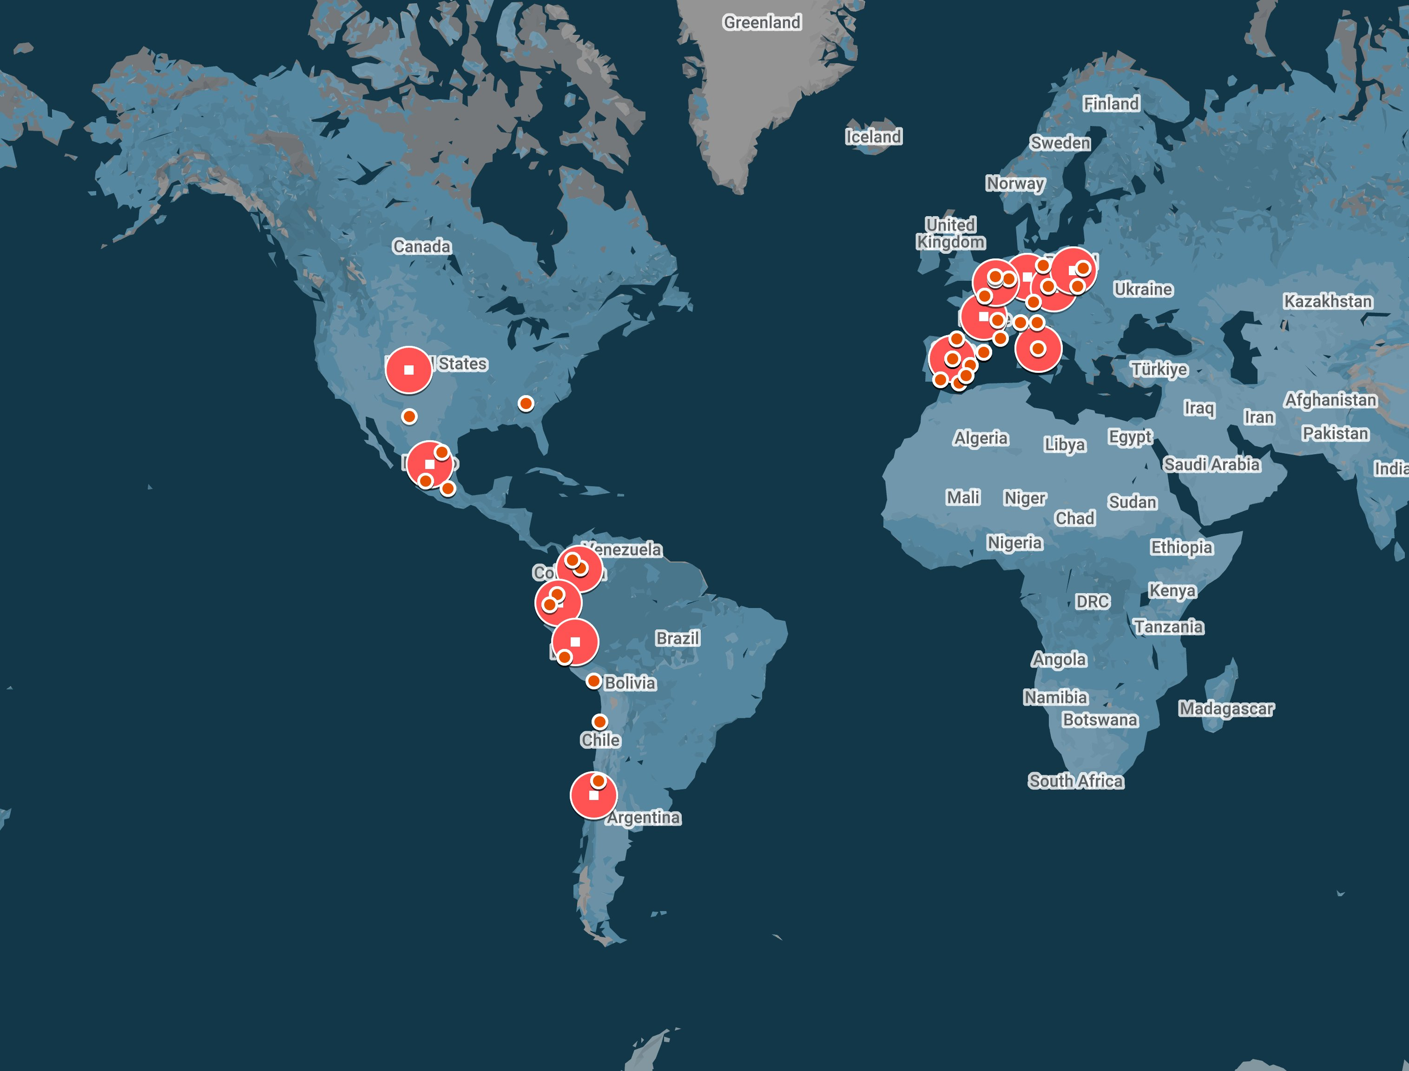
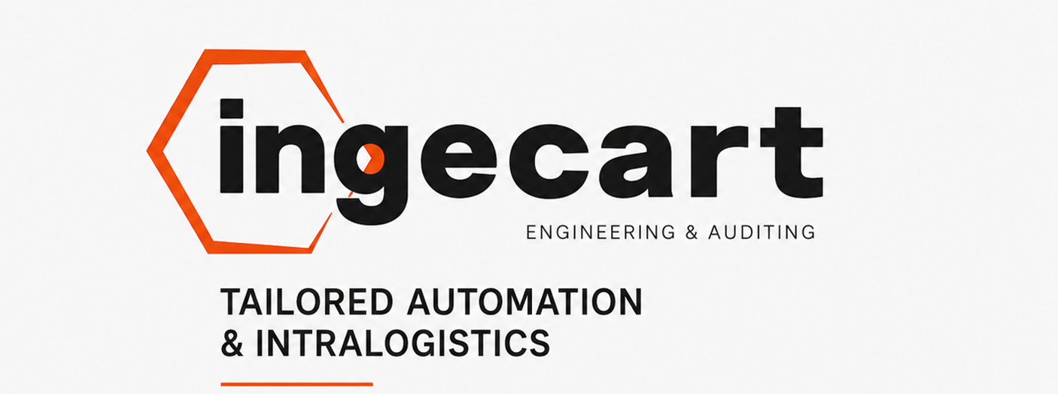
1.268 28 26 194
Projects Years Agreements Installations

Slide 3
WHAT WE DO
Industrial machinery Operational efficiency and reduced manual handling
Installation & commissioning Seamless integration into your existing plant flow
Robotics & palletizing Lower error rates, higher throughput, improved safety
Project management Single point of contact for the entire project lifecycle
360° turnkey solution Design, execution, training, and startup from A to Z
Technical auditing Independent diagnosis, free from manufacturer bias
Industrial Intelligence (Ing_PRO) AI applied to operations, maintenance, and quality
The Corrugated Plant of the Future

Slide 4
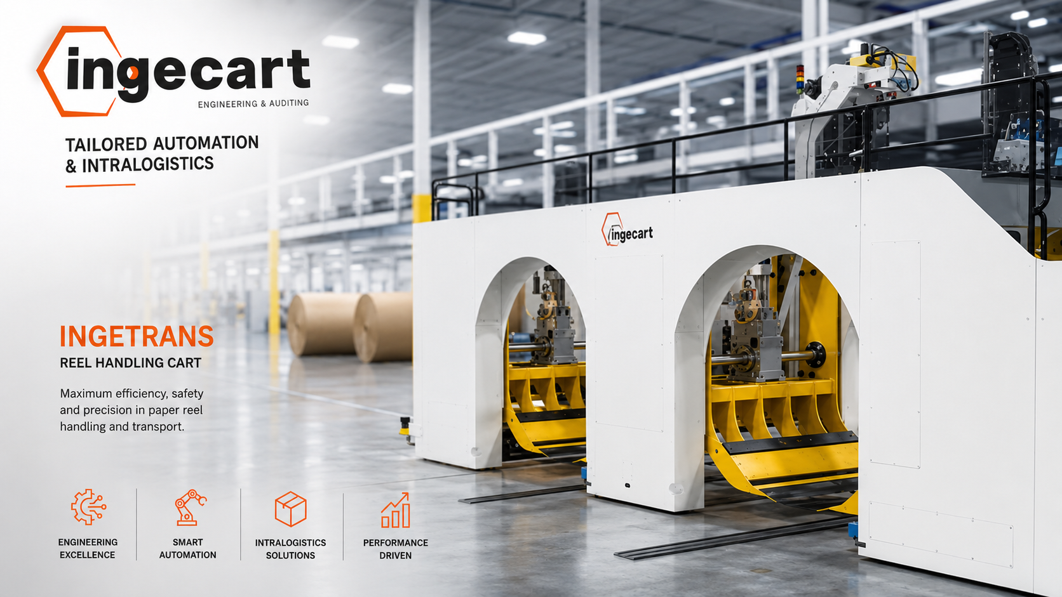

Slide 5
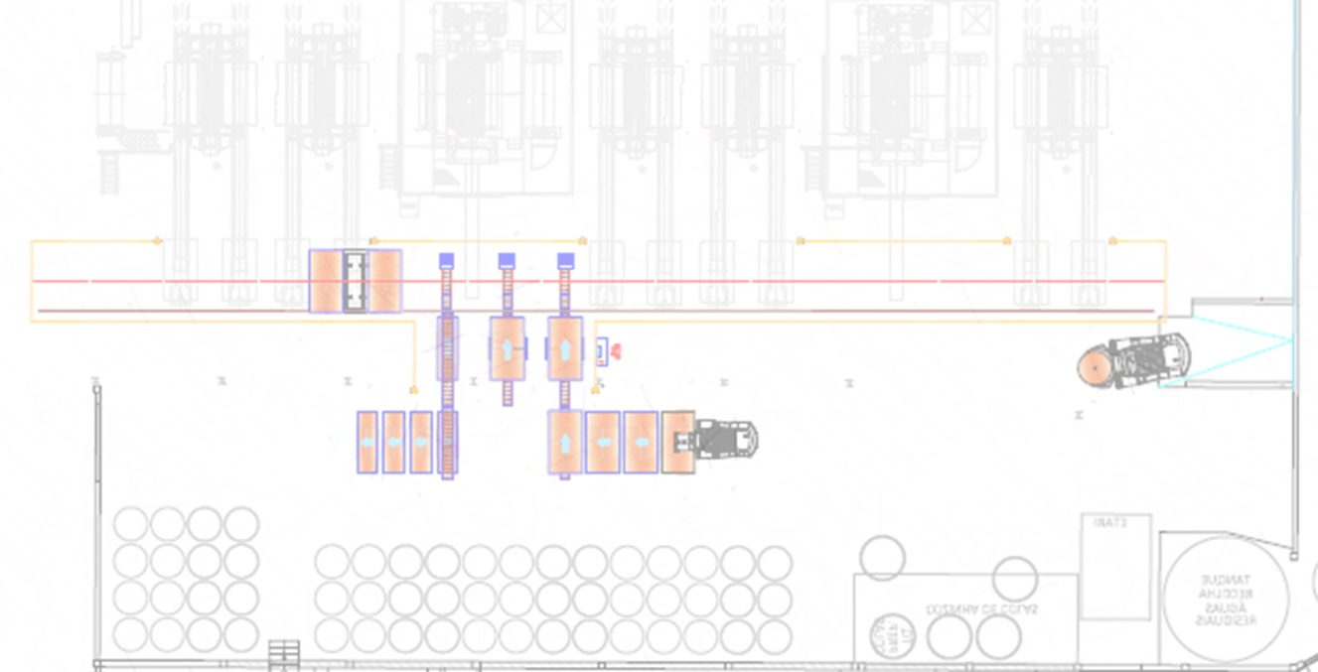
INTRALOGISTICS INGETRANS
Automated Corrugator Paper Reel Feeding System
INGETRANS is a complete automated solution for managing paper reel supply to multiple consumption points on the corrugator, including the automatic return of unused, or partially used, reels to their assigned storage locations. Designed and manufactured by Ingecart, this system eliminates forklift dependency, reduces accident risks, and significantly improves operational efficiency.
KEY FUNCTIONS
- Automated movement: Rells are transported from warehouse to corrugator without manual intervention
- Automated delivery: Precise delivery to multiple consumption points (single facers, roll stands)
- Automated return: Unused rolls are automatically returned to assigned warehouse locations
- Process integration: Works seamlessly with production planning systems

Slide 6
INTRALOGISTICS INGETRANS
Ingetrans– Corrugator Relel Change Cycle Time Calculation
Calculation basis: Delivery and return cycle for 5 rolls,
Minimum Order Length at 300 m/min
Description | Seconds | Minutes
Total cycle time – Delivery & return of 5 rolls | 346.72 | 5.78
Average time per roll | 69.34 | 1.16
Parameter | Value | Unit
Corrugator speed | 300 | m/min
Minimum order length at 300 m/min | 1,733.6 | meters

Slide 7
INTRALOGISTICS INGETRANS
TECHNICAL SPECIFICATIONS
- System type: Surface rail-guided vehicle
- Track system: Floor-mounted rails
- Operation: Fully automated (no forklift or direct personnel intervention)
- Adaptability: Custom design per client layout (number of lanes, length, consumption points)
- Integration: Compatible with customer's planning / MES system
BENEFITS
- Eliminates forklift traffic – removes uncontrolled vehicle movement from corrugator work area
- Reduces accident risk – protects personnel operating near machines
- Labor cost reduction – minimizes manual roll handling tasks
- Minimizes downtime – rolls arrive exactly when needed
- Fast ROI – quick payback through efficiency gains and cost savings
- Increased profitability – higher overall equipment effectiveness (OEE)
HOW IT WORKS
1. Start – The process begins in the customer's warehouse
2. Transport – The Ingetrans carriage moves along floor-mounted rails
3. Delivery – Rolls are delivered to consumption points on the corrugator
4. Return – Unused rolls are automatically returned to assigned locations

Slide 8
More meters per minute. Zero chaos at the corrugator.
Safe productivity for corrugated plants.
More real line capacity: continuous, production-synchronized supply.
Automates reel movement, delivery, and return from warehouse to corrugator.
Creates safer workspaces by eliminating uncontrolled circulation.
The Corrugated Plant of the Future

Slide 9
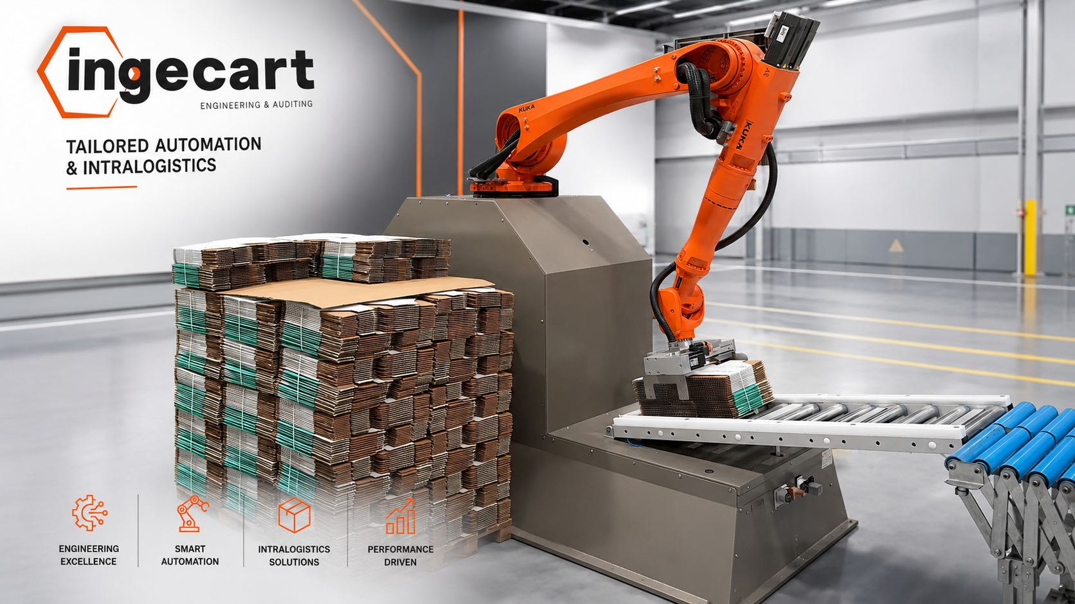
Plug&Play Palletizer + Easypack

Slide 10
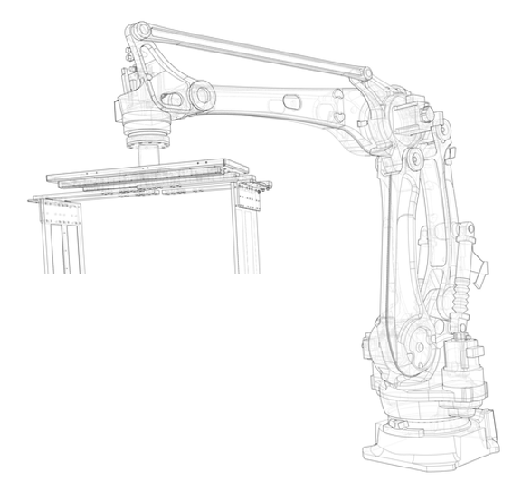
Plug&Play Easypack+Palletizer : Stack higher. Stack faster. Zero errors..
15 packages per minute.
🔌 No production stoppage. Plug, configure, and palletize.
🛠️ Universal gripper. 50+ sizes. Zero changeover time.
No tools needed. Just a recipe.
📈 ROI: Automation pays for itself.
🧠 Multi-language HMI + ERP. Real-time data.
Traceability and control from day one.
📦 Scale without redesigning your plant.
Growth doesn't have to be complicated.

Slide 11
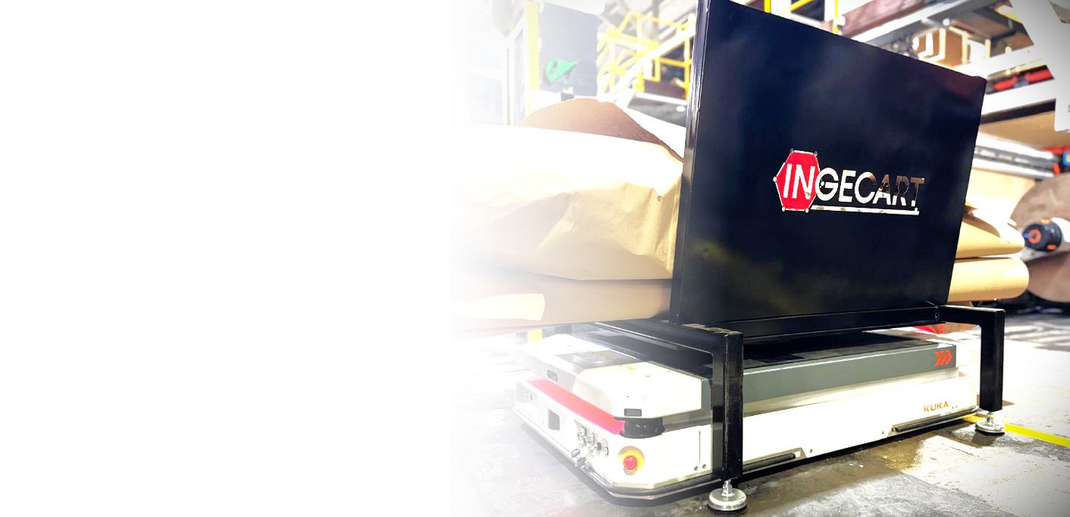
INTRALOGISTICS
AMR
INTRALOGISTICS
AMR
Supported by KUKA, Ingecart has develop
a unique automated system for improving
the WIP management, efficiency
precision cost reduction .

Slide 12
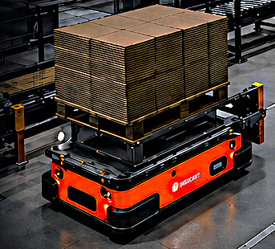
Ingecart Intralogistics Management System
AMR-Based Solution
Ingecart Intralogistics Management System – AMR-Based Solution
Automate. Optimize. Maximize Every Square Meter.
Autonomous Mobile Robots (AMRs) significantly increase efficiency in storage and production environments. They automate transport and logistics processes, accelerating task execution and optimizing goods flow.
Ingecart's compact and flexible AMR models integrate seamlessly into existing supply chains – saving substantial time and resources.

Slide 13
Ingecart Intralogistics Management System
AMR-Based Solution
Fully automated movement of loads, WIP, and finished goods between warehouse, production, and converting machines
Real-time communication with production planning systems
📦 Logistics Efficiency
Just-in-time delivery of materials to converting stations
Reduced waiting times and improved overall equipment effectiveness (OEE)
Synchronized material flow aligned with production pace
📐 Maximum Space Utilization (WIP per m²)
Compact AMR design navigates narrow aisles and tight spaces
Optimized WIP placement in minimum footprint
Intelligent routing allows higher storage density without adding square meters
🔁 Flow Management Between WIP & Converting Machines
Dynamic management of work-in-progress buffers

Slide 14
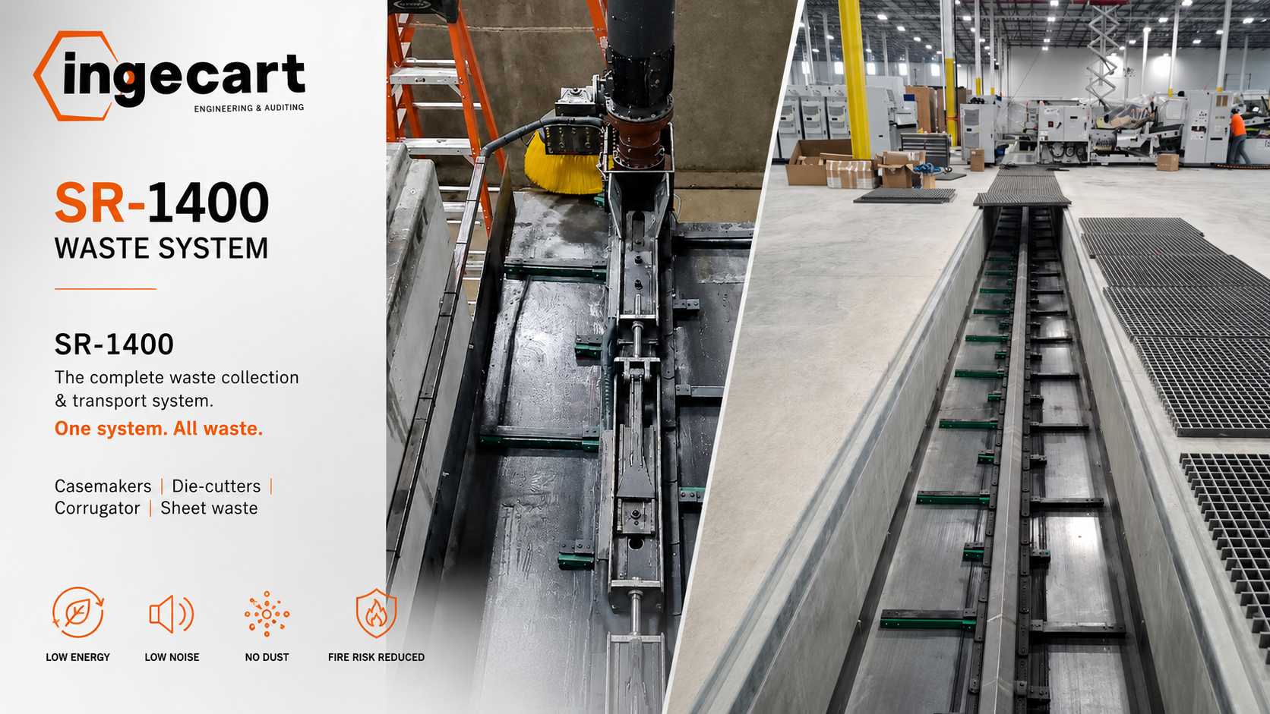

Slide 15
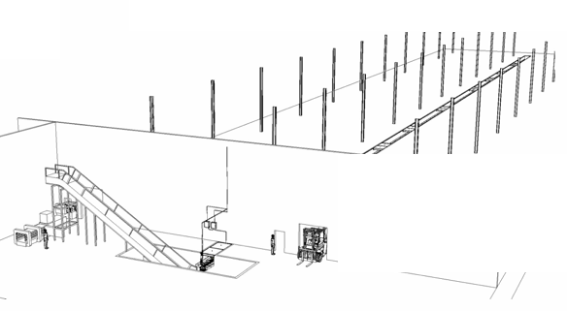
SR-1400
unified solution for collecting and transporting all waste
WHAT IT HANDLES
- Casemaker waste
- Die-cutter waste
- Corrugator waste
- Sheet waste
KEY BENEFITS
- Very low energy consumption
- Low noise level
- No airborne dust
- Reduced fire hazard

Slide 16
SR-1400
unified solution for collecting and transporting all waste
Auto-lubrication system
Sectional stop at each machine:
Safety push-buttons allow operators to stop non-operative sections, improving safety and saving energy.
Anti-wear plates at line ends
Special chain & arm design
Developed after studying multiple customer installations. Eliminates common fixing failures and constant maintenance issues.
Chain link breaking strength
35,000 kg – Metal fins allow screw fixing for easy annual inspections.
Speed inverters for flow control
Complete system integration
Waste from the corrugator is collected and transported without a cyclone, further reducing energy costs and avoiding system duplication.

Slide 17
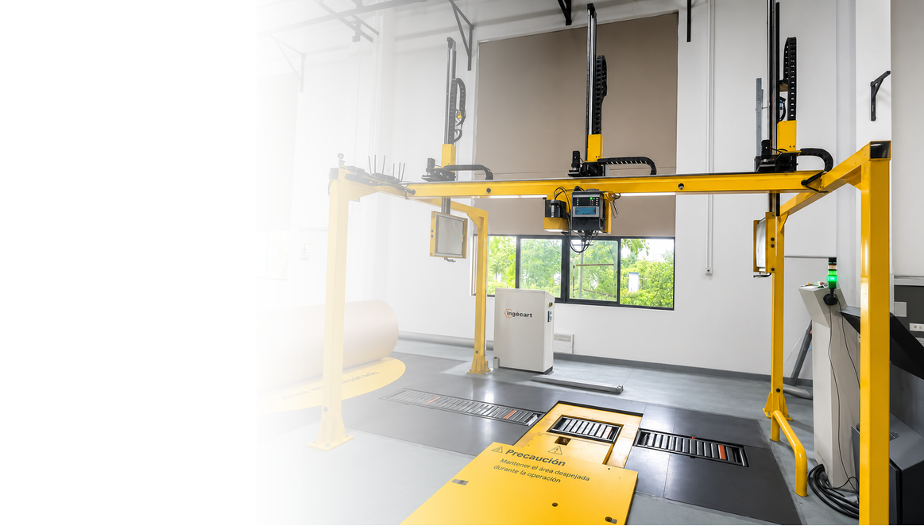
RFID
ROLL
MANAGEMENT
fully integrated, cost-effective RFID-based solution to automatically identify, track, and validate paper rolls at every critical station

Slide 18
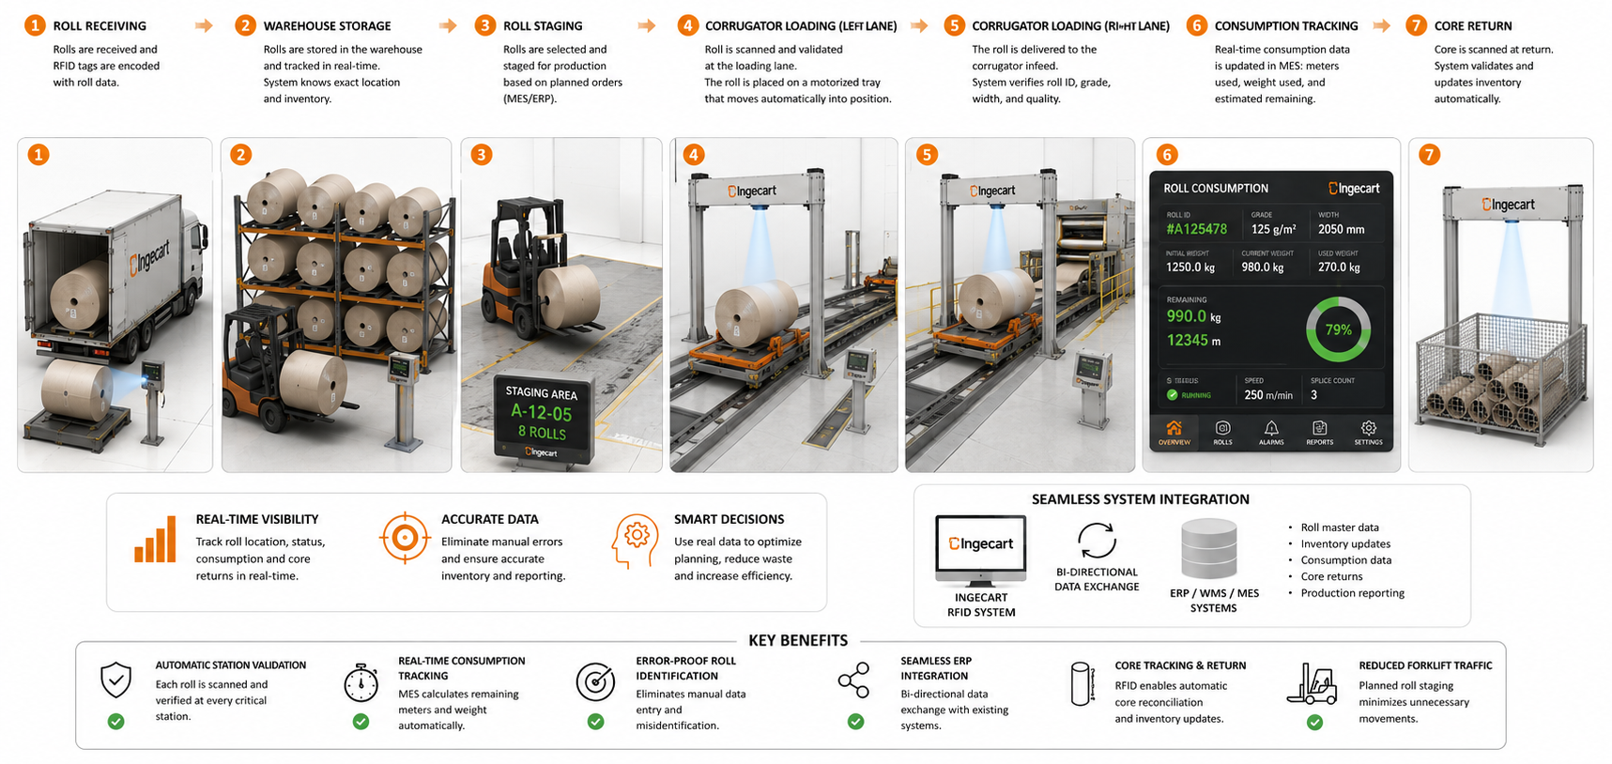

Slide 19
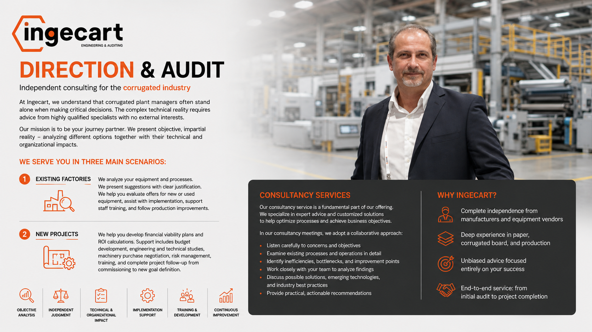

Slide 20


